Slide 1
Hall supplence & complaints
Presented by MD LAVLU MIA
Dept:ECE
Roll:1909034
Year : 3rd
^{Seassion :2021-22}
^{KUET}

Slide 2
Agenda
INTRODUCTION 3
ER Diagram 4
Table 5
end

Slide 3
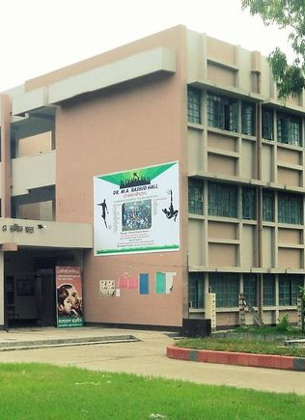
Introduction
This project is about to make hall management system more advanced and vast.Students info are save efficiently. Monthly hall dues can easily seen by a student. Any students can be complain to the hall provost. Students extra curriculam activities can be nourished as these info are save accordingly.Player student can be filtered easily overview. Student can also save their necessary suppliance and as well as complaints infofmation and so this problem can be solve efficiently.

Slide 4
ER Diagram
Student_Name
Stu_info
Roll_No
Roll_no
Room_no
Border_no
Border_no
Dues
Hall_Dues
Student_info
Massing
Dept
password
Total
Fine
Extra_
curriculam
complaints
Border_no
Supply and complaits
Sl_no
Extra_curriculam
Stu_name
Room_no
complain
supply
Border_no
sports
Date
contact
Sports_man ratting
cricket
Border_no
TT
others

Slide 5
d
Table
Stu_Info
Stu_name | Roll | Border_no | Dept | Username | password | Contact_no | Email | Room_no
A | 1909034 | 2052 | ECE | aa | 1234 | 01951423 | aa@gmail.com | 117
Dues
Stu_name | Roll | Border_no | messing | fine | other | total
a | 1909034 | 2052 | 2000 | 100 | 50 | 2150
Supply and complains
roll | Border_np | name | date | supply | complains | Room_no
1909034 | 2052 | A | 05-11-2023 | aa | bb | 117
Extra curricular
Border_no | roll | name | contact | Room_no
2052 | 1909034 | a | 019076654 | 117
Sportsman ratting
Border no | roll | Name | football | cricket | TT | badminton
2052 | 1909034 | a | yes | no | yes | yes

Slide 6
Thank You

